Slide 1
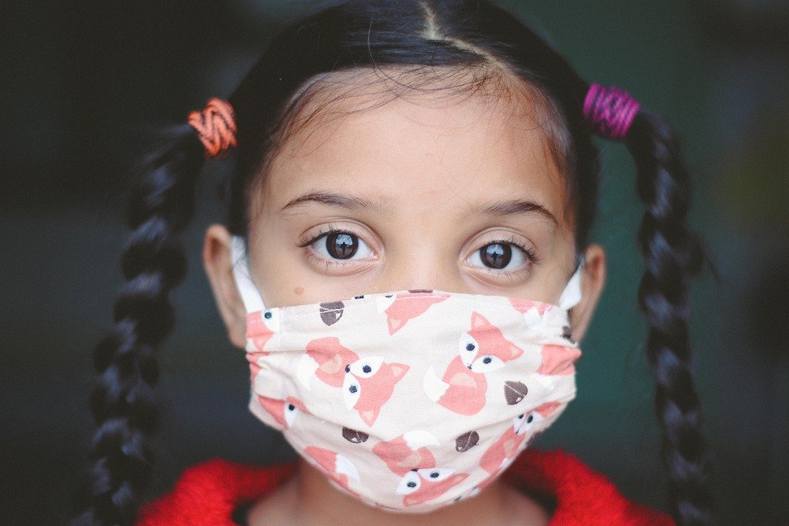
Fintech Boot Camp
Project-Two
September 7, 2021

Slide 2


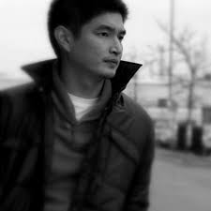


Project-Two: Mask Detection Team
Grace
Zai
The Analyst
John Mangahas
The Educator
Martin Mangahas
The Legal Adviser
Ethol Palmer
The Tech Lead
Monique Rowe
The Banker

Slide 3
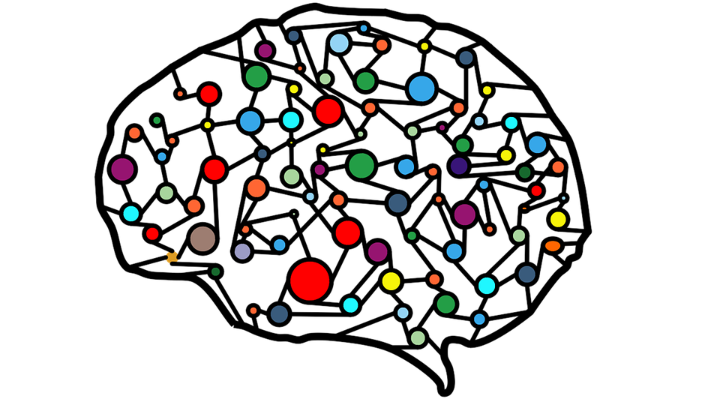
Convolutional Neural Network
A convolutional neural network (CNN) is a type of artificial neural network used in image recognition and processing that is specifically designed to process pixel data
Notes:
Data Cleanup & Model Training
Describe the exploration and cleanup process. (Kaggle)
Discuss any problems that arose with preparing the data or training the model that you didn't anticipate. (Which data is supposed) edited is not factor.
Discuss the overall training process and highlight anything of interest with the training process: Cloud resources used, training time required, issues with training.
https://deeplizard.com/resource/pavq7noze2
Image detection uses functional models using Keras. Our project uses MobileNetV2 as our base model.
Hyper parameters to be tested.

Slide 4
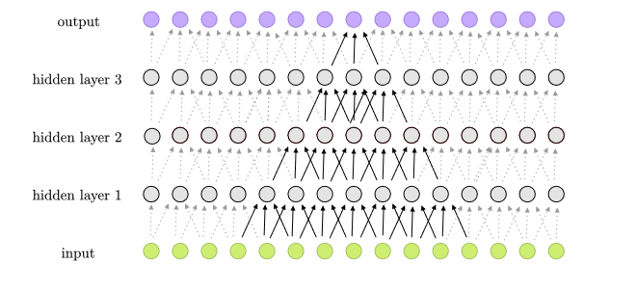

Slide 5

Notes:
Convolution Demo

Slide 6
Motivation & Summary
Detection Models
Amazon Rekognition
Milestones Objectives
Objectives
Build deep learning models to detect faces and individuals wearing masks
_______________________
Use various databases of images and videos to test our models confidence intervals
Deploy and configure Amazon Rekognition to detect masks and validate initial results.
Rekognition
Extend project to detect other PPE equipment
________________________
Deploy a chatbot with Amazon Rekognition capabilities
Notes:
Image detection uses functional models using Keras. Our project uses MobileNetV2

Slide 7
Process & Workflow
Training Phase
Detection of Face Mask
Phase
Production of Results
and Validation
Loading of the dataset
Training the model
Updating the model
Loading trained model
Detection of faces and mask in images or video
Extraction data
Application of detector
Production of results:
Mask
Without Mask
Validation of results using Amazon Rekognition
Input
Notes:
Model Summary
Continuous update the model
Elaborate on the predictive model used, describing why it was the best choice for the data.
https://deeplizard.com/resource/pavq7noze2
Detection Face - Load the Model -> Feed Images (Different Training Dataset) -> Detect (Does it have face?) -> Data -> Detector (Now evaluate) = Yes or No

Slide 8
Predictions
Deployed Model will not be perfect
It will take a lot of resources and time to be able to train the model
Computing power and hardware will be an issue later on
Collection of high quality data set for input and training will play a factor in the accuracy of the model
AWS Rekognition will be more accurate

Slide 9

Technologies/Tools/Library
Tensorflow
Keras
MobileNetV2
Sklearn
Numpy
OS
CV2
Argparse
Imutils
Boto3
Amazon Sagemaker
Amazon S3 Bucket
Amazon Rekognition
Notes:
Describe the exploration and cleanup process.
Discuss any problems that arose with preparing the data or training the model that you didn't anticipate.

Slide 10
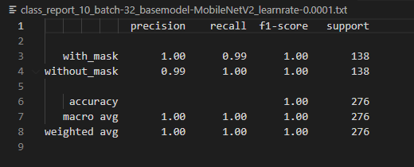
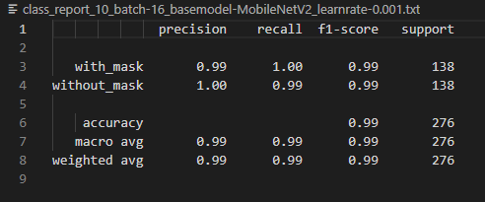
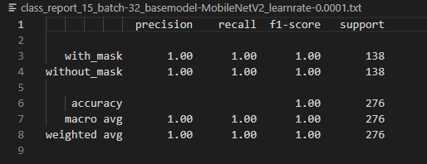
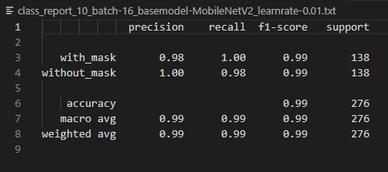
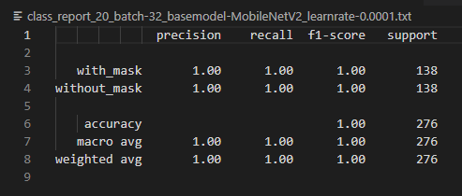

Notes:
Discussion Results

Slide 11
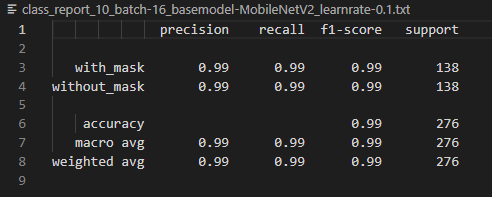
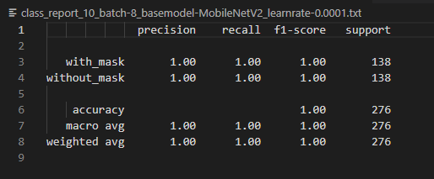
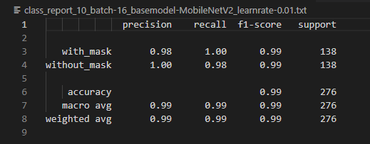
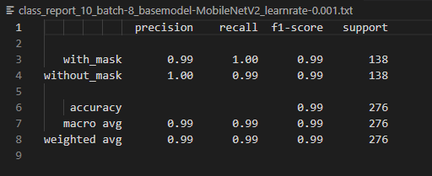
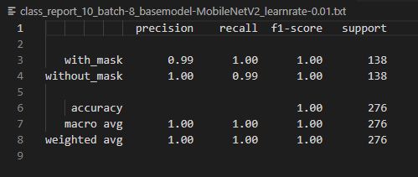
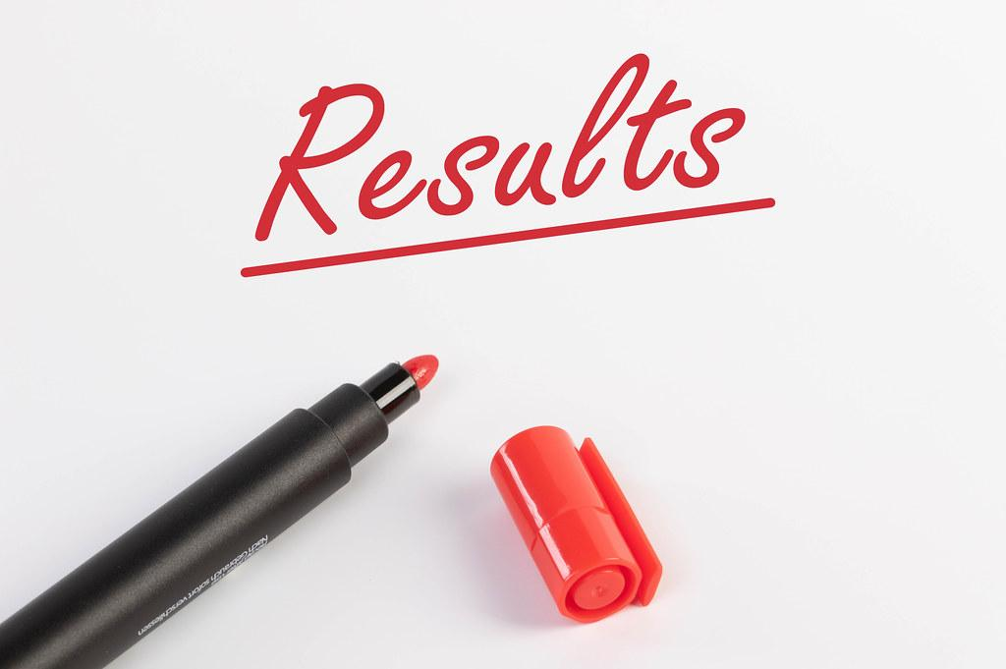

Slide 12

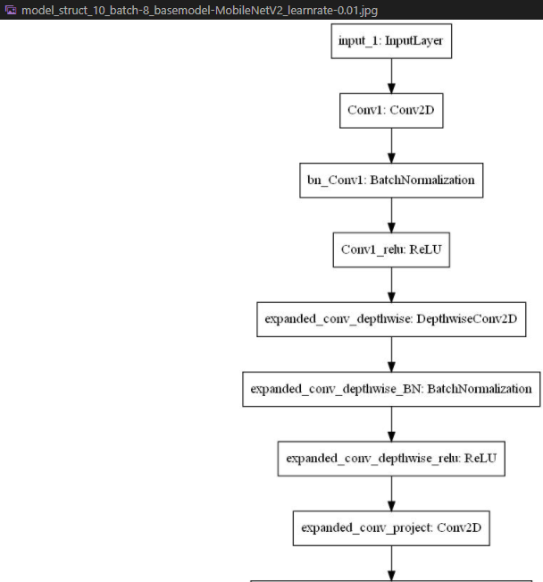

Slide 13
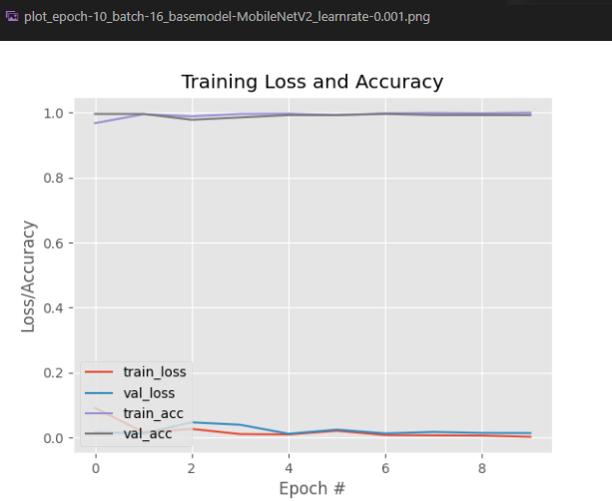
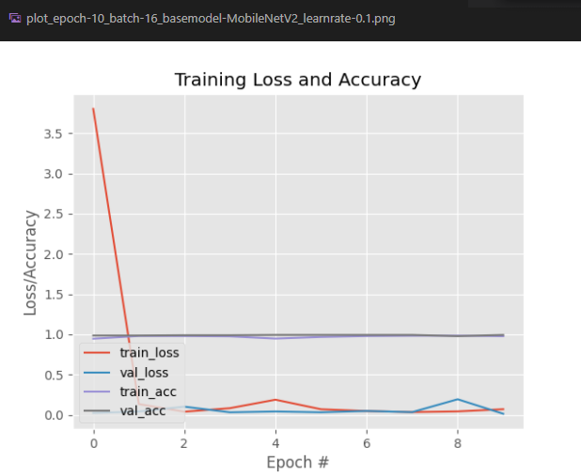
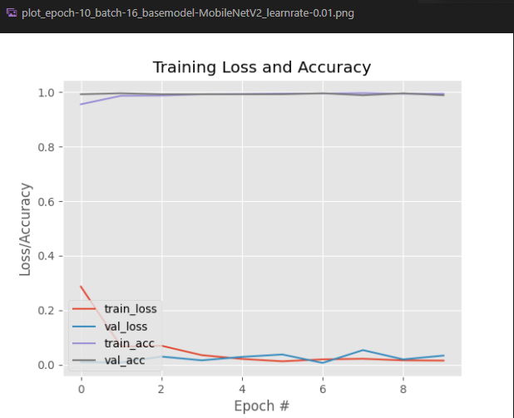
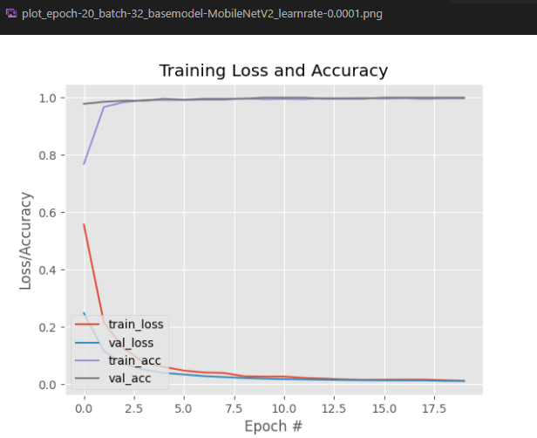
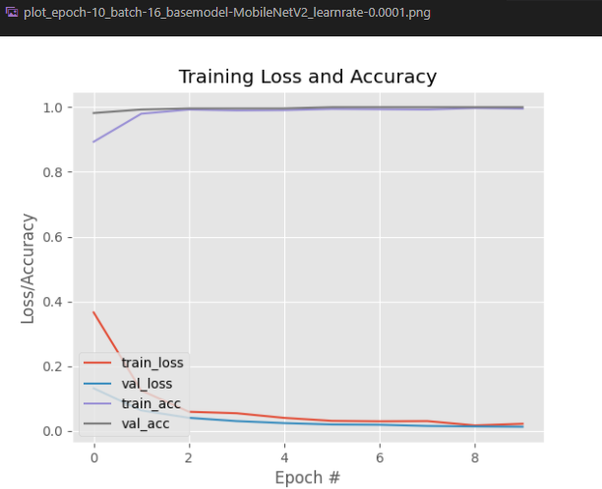
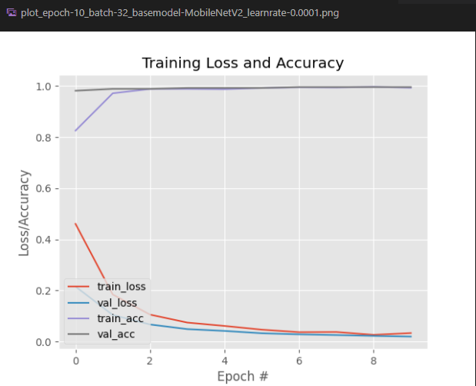
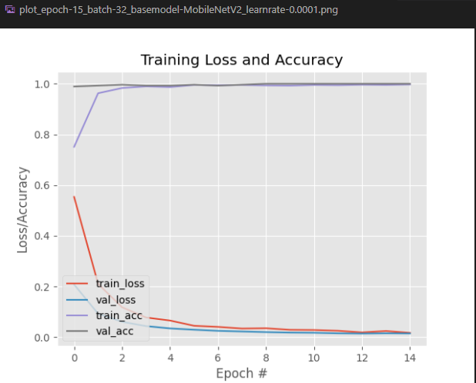


Slide 14
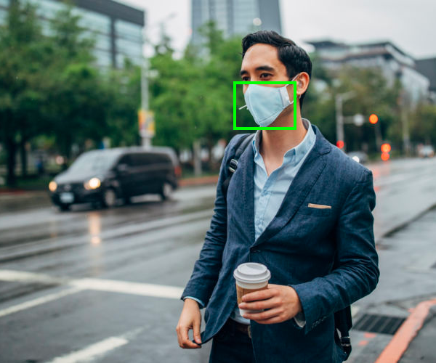
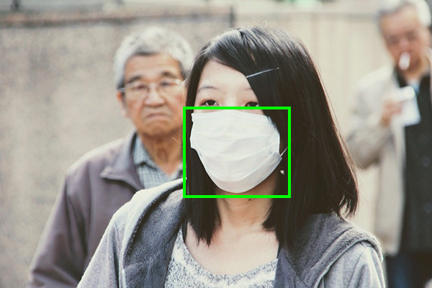
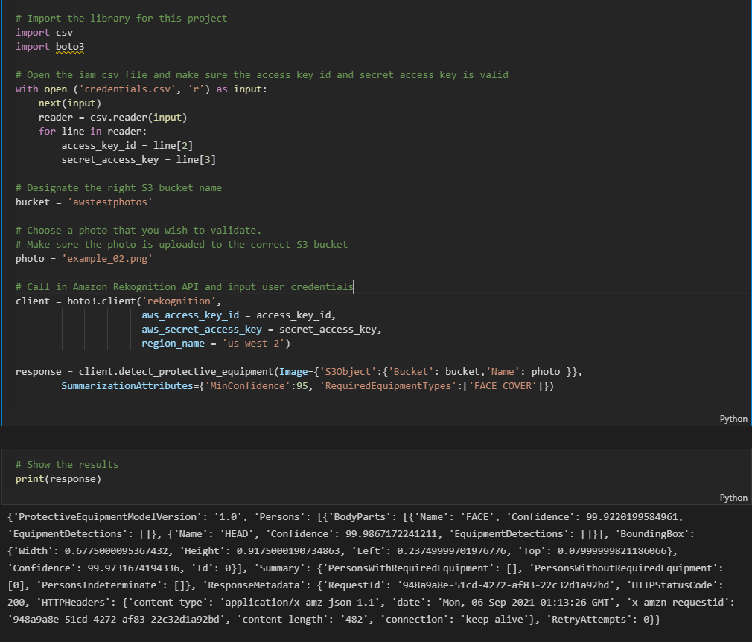
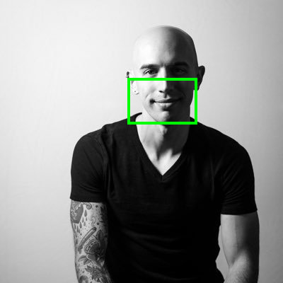
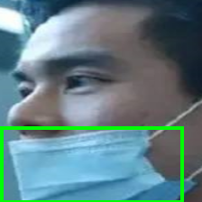
Output and Validation

Slide 15
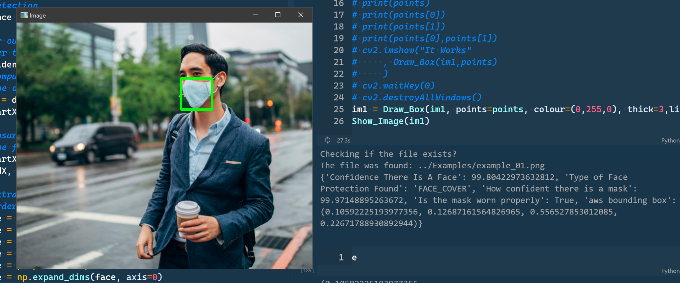

Slide 16
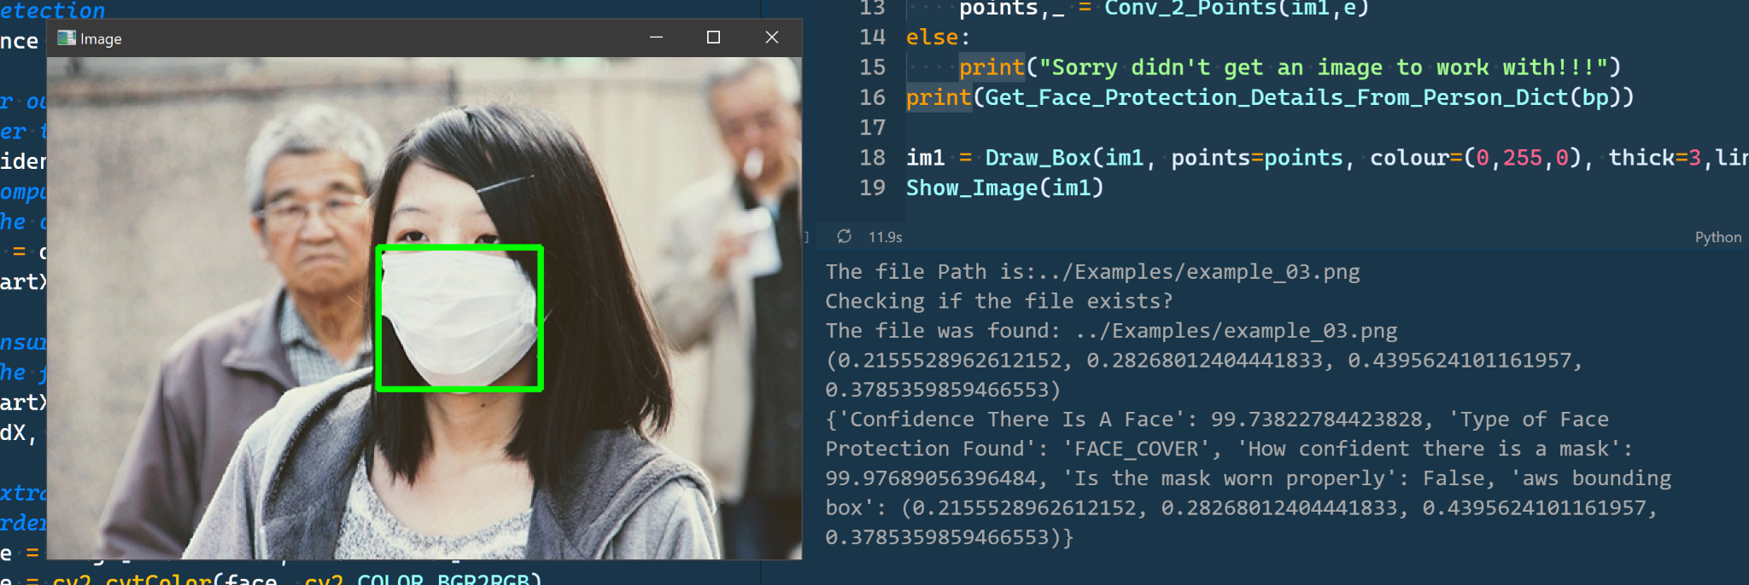

Slide 17
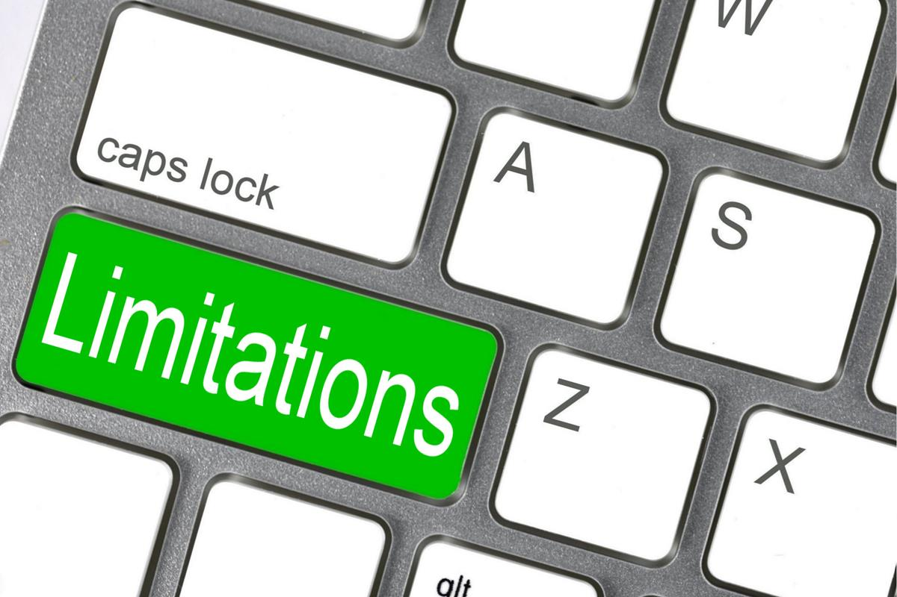
Limitations
Training the models to detect if a subject is wearing a mask properly
Need for a large dataset and variation for training the model
Face detector can identify multi-faces from the picture/video; but, mask detector is set for detecting mask for the face with highest confidence only
Processing power of cpu and gpu
Time constraint to explore different models and apply different hyper parameters.
Notes:
https://keras.io/api/applications/#usage-examples-for-image-classification-models

Slide 18

Conclusion
Deployed Model is able to detect face and facemask
Current model needs to be trained and updated regularly
High computing power and quality hardware is required
Validation using AWS Rekognition is highly effective

Slide 19
Postmortem
Configure current model to detect other ppe equipment
Train the model to evaluate if a person is wearing a mask properly
Explore different keras models and apply different hyper parameters.
Deploy a chatbot where user can pass an image and the bot will be able to use Amazon Rekognition to detect ppe equipment in the image
Notes:
Discussion Results

Slide 20
Demo
Notes:
https://i.gifer.com/origin/5e/5e26bf48815bb0a335d61fce26b7f40f_w200.webp
https://keras.io/api/applications/#usage-examples-for-image-classification-models

Slide 21
Questions?
Notes:
https://i.gifer.com/origin/5e/5e26bf48815bb0a335d61fce26b7f40f_w200.webp
https://keras.io/api/applications/#usage-examples-for-image-classification-models

